Slide 1

Infection and Transmission of SARS- CoV-2
May 27. 2020
K.Dharmalingam

Slide 2
Spread occurs from all these groups of patients
Asymptomatic Likely but remote
Prodromal Yes
Oligosymptomatic Yes
Polysymptomatic Yes

Slide 3
Spread from asymptomatic people
Fauci, for one, still believes it does.
"This evening I telephoned one of my colleagues in China who is a highly respected infectious diseases scientist and health official," he says. "He said that he is convinced that there is asymptomatic infection and that some asymptomatic people are transmitting infection." But even if they do, asymptomatic transmission likely plays a minor role in the epidemic overall, WHO says.
Counterpoint
Study claiming new coronavirus can be transmitted by people without symptoms was flawed
By Kai Kupferschmidt Feb. 3, 2020 , 5:30 PM. Science.

Slide 4
Sites of active viral replication has direct relevance to the transmission

Slide 5
1
Active viral replication in upper respiratory tract and
its implication for the containment of COVID-19
Nature Medicine. 2020, 26. 465

Slide 6
Viral RNA load in upper respiratory tract
The average virus RNA load was 6.76 × 10 ⁸copies per whole swab until day 5,
The maximum load was 7.11 × 10⁸ copies per swab.
Swab samples taken after day 5 had an average viral load of 3.44 × 10⁵ copies per swab
Notes:
Initial inociulum can not be this huge

Slide 7
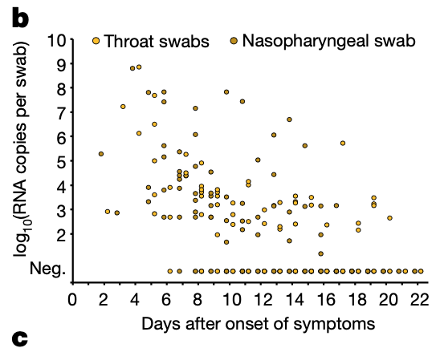
There were no discernible
differences in viral loads or
detection rates when comparing
naso- and oropharyngeal swabs .

Slide 8
Independent replication in the throat is provided by sequence findings in one patient, who consistently showed a distinct virus in the throat as opposed to the lung. Two viral genotypes in the same patient.
The disturbance of gustatory and olfactory senses points at an infection of the tissues of the upper respiratory tract.
Together, these data indicate the active replication of SARS-CoV-2 in the throat during the first five days after the onset of symptoms. No (or only minimal) indications of replication in stool were obtained by the same method (Fig. 1g). See later for a current study

Slide 9
SARS-CoV-2 transmission is more efficient than SARS-CoV
Active pharyngeal viral shedding at a time at which symptoms are still mild and typical of infections of the upper respiratory tract is unique to SARS-CoV-2 .
Later in the disease, COVID-19 resembles SARS in terms of replication in the lower respiratory tract.

Slide 10
2.
Is intestinal tract additional route of infection?
1.Development of gastrointestinal symptoms in some patients with COVID-19 .
2. Detection of viral RNA in faecal specimens in 53% of a cohort of 73 patients
3. Demonstration of of active SARS-CoV-2 replication in human enteroids, an in vitro model of human intestinal epithelium
4. Isolation of infectious virus from a patient with diarrheal COVID-19
Currently, the route(s) leading to enteric infection remains unclear.
Intestinal epithelial cells are primarily infected with SARS-CoV-2 via the oral–fecal route or
Whether enteric infection is secondary to respiratory infection.
Nature Medicine May 13.

Slide 11
Direct and indirect transmission of SARS -CoV-2
1.Droplet/aerosol
2. Fecal
3. Surface transmission. (INDIRECT)

Slide 12
Stability of SARS CoV2 in aerosol and surfaces
Measurement done using the titre of virus
Tissue-culture Infectious Dose [TCID50] per milliliter)
SARS-CoV-2. Viral strain used
nCoV-WA1-2020 (MN985325.1)
N Engl J Med April 16, 2020

Slide 13
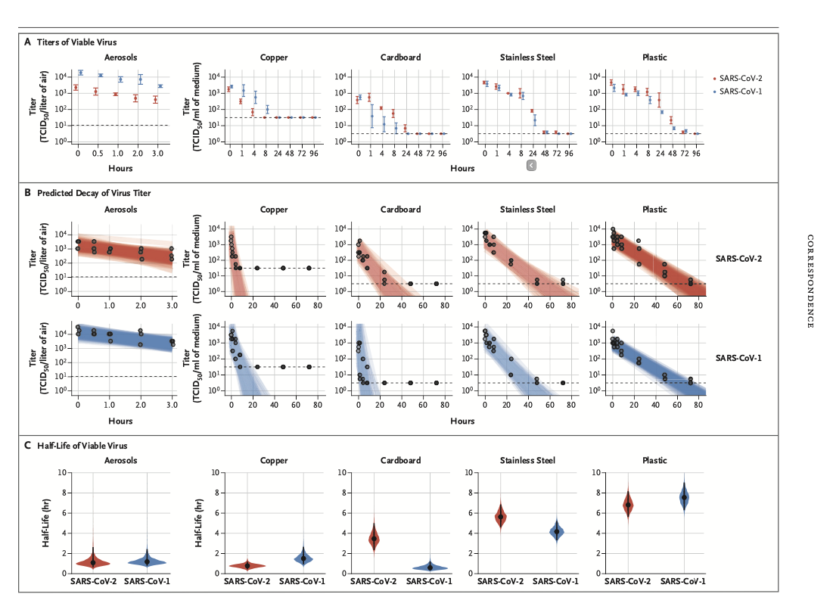
Orange SARS CoV-2
Blue SARS CoV-1

Slide 14
Airborne or Droplet Precautions for COVID-19
Journal of Infectious Diseases 2020

Slide 15
Droplet. Vs Aerosol
The WHO uses a cutoff limit of 5 μm to differentiate between aerosols (≤5 μm) and droplet (>5 μm) [38] transmission routes.
In addition, the size of a droplet is dynamic and changes within seconds during the transit from the respiratory tract to the environment due to evaporation. Ambient condition is critical.
Eight of the 10 studies discussed a horizontal trajectory greater than 2 meters (≈6 feet) for a range of droplet sizes of less than 60 μm

Slide 16
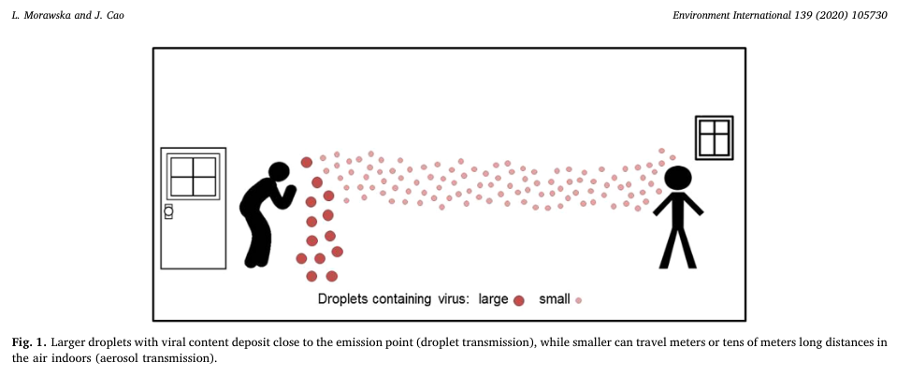

Slide 17
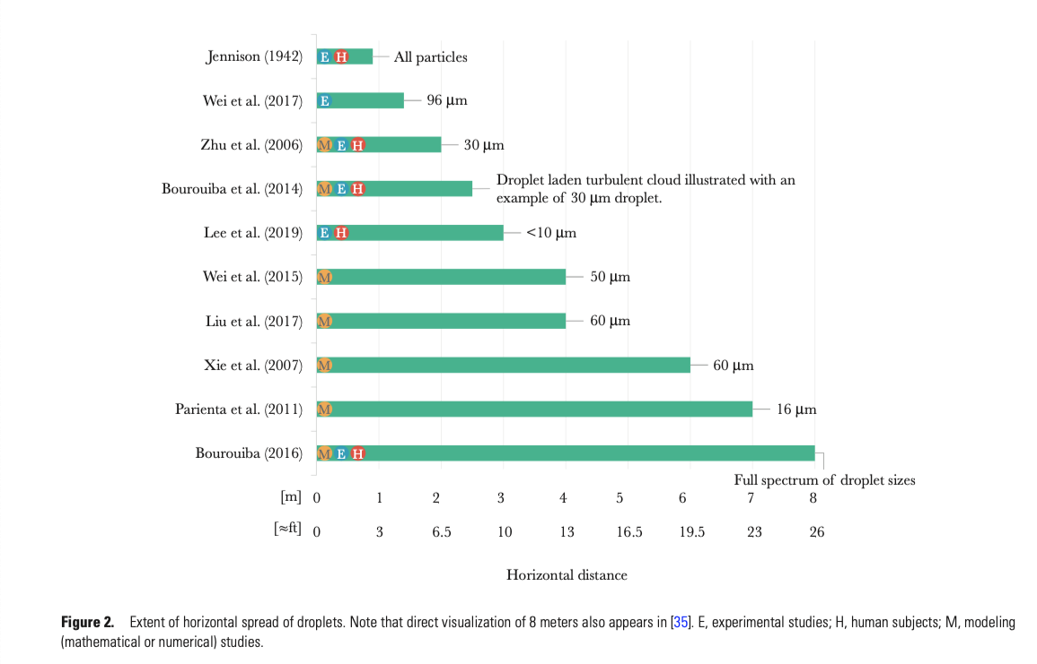

Slide 18
Aerosol transmission of previous SARS. virus
Earlier SARS (not CoV-2) was classified as predominantly transmitted through contact and droplet modes, but aerosolized transmission well beyond 2 meters (≈6 feet) was reported in the Amoy Gardens outbreak [32].

Slide 19
Aerosol transmission possible but no data on live viral load
available
This further supports the conclusion that transmission cannot be neatly separated into droplet versus airborne routes, and that it is likely driven by both airborne, and large droplets, carried by the respiratory gas cloud.
In light of the lack of definitive transmission data for SARS-CoV-2, as well as persistence of the virus in the air 3 hours after aerosolization in
laboratory settings [33], the precautionary principle in the initial
CDC guidance was justified

Slide 20
Emerging Infectious Diseases. Volume 26, Number 7—July 2020
https://doi.org/10.3201/eid2607.200885
SARS-CoV-2 was widely distributed in the air and on object surfaces in both the ICU and GW, implying a potentially high infection risk for medical staff and other close contacts.
2. The environmental contamination was greater in the ICU than in the GW; thus, stricter protective measures should be taken by medical staff working in the ICU.
3. The SARS-CoV-2 aerosol distribution characteristics in the GW indicate that the transmission distance of SARS-CoV-2 might be 4 m.

Slide 21
Emerging Infectious Diseases. Volume 26, Number 7—July 2020
https://doi.org/10.3201/eid2607.200885
Our study has 2 limitations.
The results of the nucleic acid test do not indicate the amount of viable virus.
For the unknown minimal infectious dose, the aerosol transmission distance cannot be strictly determined.
Overall, we found that the air and object surfaces in COVID-19 wards were widely contaminated by SARS-CoV-2. These findings can be used to improve safety practices.

Slide 22
Our results indicate that aerosol and fomite transmission of SARS-CoV-2 is plausible, since the virus can remain viable and infectious in aerosols for hours and on surfaces up to days (depending on the inoculum shed).
Our initial results suggest that measures to contain viral spread should aim at droplet, rather than fomite, based transmission.

Slide 23
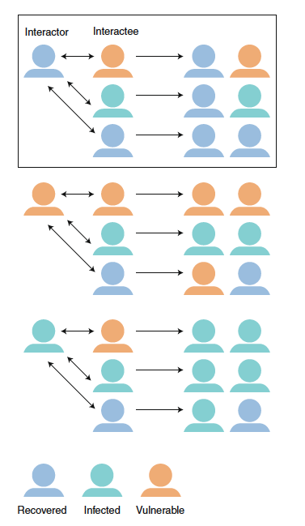
Interaction substitution to prevent the spread of COVID-19.
Societies over the next few months will
face the choice between continued lockdown
with huge economic and social costs for
everyone, versus lifting restrictions and
replacing them with effective public-health
interventions, including advice on social
distancing, hygiene, protection of high-risk
groups and widespread testing.
Nature Medicine | www.nature.com/naturemedicine

Slide 24
Part II

Slide 25
Aerosol transmission of SARS- CoV-2is real.
Six feet social distancing may be in adequate, if we encounter
asymptomatic “silent shedders”.
Increasing evidence for SARS-CoV-2 suggests the 6 ft WHO recommendation is likely not enough under many indoor conditions where aerosols can remain airborne for hours, accumulate over time, and follow air flows over distances further than 6 ft
Reducing transmission of SARS-CoV-2. Science. 27 ,May. 2020.
K.Dharmalingam
29 May

Slide 26
79% of transmission is through the silent transmitters
Evidence suggests that SARS-CoV-2 is silently spreading in aerosols exhaled by highly contagious infected individuals with no symptoms. Owing to their smaller size, aerosols may lead to higher severity of COVID-19 because virus-containing aerosols penetrate more deeply into the lungs.

Slide 27
Viral Load in the Aerosol Produced by the Speaker.
Estimates using an average sputum viral load for SARS-CoV-2 indicate that 1 min of loud speaking could generate >1000 virion-containing aerosols. Assuming viral titers for infected super-emitters (with 100-fold higher viral load than average) yields an increase to more than 100,000 virions in emitted droplets per minute of speaking.

Slide 28
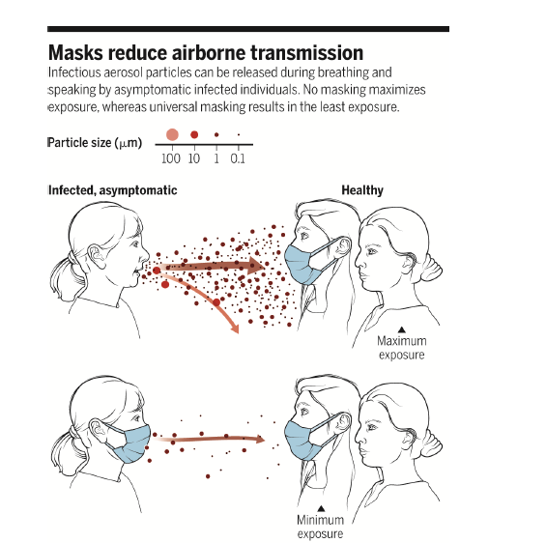
It is essential that control measures be introduced to reduce aerosol transmission.

Slide 29
Ref.
Reducing transmission of SARS-CoV-2
Kimberly A. Prather1, Chia C. Wang,2,3 Robert T. Schooley4
1Scripps Institution of Oceanography, University of California San Diego, La Jolla, CA 92037, USA. 2Department of Chemistry, National Sun Yat-sen University, Kaohsiung, Taiwan 804, Republic of China. 3Aerosol Science Research Center, National Sun Yat-Sen University, Kaohsiung, Taiwan 804, Republic of China. 4Department of Medicine, Division of Infectious Diseases and Global Public Health, School of Medicine, University of California San Diego, La Jolla, CA 92093, USA. Email: kprather@ucsd.edu
Masks and testing are necessary to combat asymptomatic spread in aerosols and droplets

Slide 30
Thanks

